Slide 1
Chapter 13
Biological Basis of Behaviour Disorders

Slide 2
Affect disorders
Diagnostic and Statistical Manual of Mental Disorders (4th edn), known as the DSM-IV.
It assesses five dimensions:
Axis I: Clinical Syndromes
Axis II: Developmental Disorders and Personality Disorders
Axis III: General Medical Conditions
Axis IV: Severity of Psychosocial Stressors
Axis V: Global Assessment of Highest Level of Functioning

Slide 3
DSM-IV
Axis I: Clinical Syndromes
This is what we typically think of as the diagnosis (e.g. depression, schizophrenia, social phobia)
Axis II: Developmental Disorders and Personality Disorders
Developmental disorders include autism and mental retardation, disorders which are typically first evident in childhood
Personality disorders are clinical syndromes. They include Paranoid, Antisocial, and Borderline Personality Disorders
Axis III: General Medical Conditions
Which play a role in the development, continuation or exacerbation of Axis I and II disorders

Slide 4
DSM-IV
Axis IV: Severity of Psychosocial Stressors
Events in an individual’s life, such as the death of a loved one, starting a new job, college, unemployment, and even marriage, can impact the disorders listed in Axis I and II. These events are both listed and rated for this axis.
Axis V: Global Assessment of Highest Level of Functioning
Functioning both at the present time and the highest level within the previous year. This helps the clinician understand how the above four axes are affecting the person and what type of changes can be expected

Slide 5
Affective disorders
Persistence of high levels of depression or mania
Major depression
Dysthymia
Bipolar disorder

Slide 6
Characteristics of depression
Depressed mood
Diminished interest in activities
Weight loss
Insomnia or hypersomnia
Agitation
Psychomotor retardation
Fatigue or loss of energy
Feelings of worthlessness or guilt
Diminished ability to think or concentrate
Recurrent thoughts of death, suicidal ideation

Slide 7
Major depression
Depressed mood of 2 or more weeks
May last several weeks to 6 months
50% will experience another episode within 2 years
Dysthymia
Depression with less intense symptoms
A kind of low-level chronic depression
Less debilitating than major depression
May be considered to be a personality trait rather than a recognized condition

Slide 8
Mania
Elevated, expansive or irritable mood
Inflated self-esteem or grandiosity
Increased or pressured speech
Decreased need for sleep
Distractibility
Increased activity or psychomotor agitation
Flight of ideas or thoughts
Excessive involvement in high-risk activities

Slide 9
Bipolar disorder & cyclothymia
Bipolar disorder
Fluctuating manic and depressive moods
Around 1% of population has BD
Cyclothymia
Similar but less intense
Symptoms present for at least 2 years (1 or more years in children and adolescents)

Slide 10
Causes of affective disorders
Genetics
Concordance rate in identical twins much higher than in fraternal twins
Bipolar – rate of 50-100% in MZ twins
Depression – 50% in MZ twins
Estimated genetic contribution to be 5 times higher for bipolar than for depression
Many genes implicated

Slide 11
Causes of affective disorders: neurochemistry
Disrupted neurotransmitter systems in the locus coeruleus (noradrenaline) (Leonard, 1997) and 5HT systems (Arranz et al., 1994)
Major depression – lower serotonin & norepinephrine metabolite
Low levels of a serotonin metabolite (5-HIAA) have been found in individuals with major depression and recently linked to a greater suicide risk (Mann et al., 1999)
low levels of a noradrenaline metabolite (MHPG) have been found in the cerebral spinal fluid of major depressive individuals (Maas et al., 1974)

Slide 12
Neuroanatomy of depression
Reduced grey matter in the prefrontal cortex (Haldane & Frangou, 2004)
Reduction in the grey matter ventral to the beginning of the corpus callosum (Drevets, Ongur, & Price, 1998)
Underlying pathology of limbic system (Soares & Mann, 1997)
Temporal abnormalities
Seasonal Affective Disorder (SAD) is one manifestation of problems linked with the suprachiasmatic nucleus (SCN) (Howland, 2009)

Slide 13
HPA system
Hyperactivity of the adrenal gland, which is more associated with symptoms of major depression – see Chapter 10
Dexamethasone suppression test, which tests for excessive amounts of cortisol in depressive individuals (Kalin et al., 1981)

Slide 14
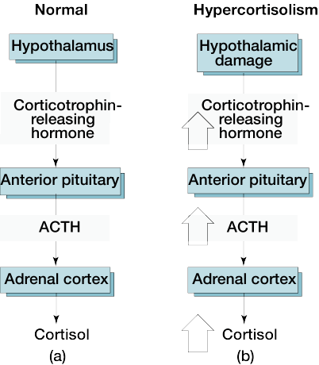
A biochemical depression marker
Hypercortisolism – in many with major depressions
Elevated corticotrophin releasing hormone – hypothalamic dysfunction
Results in elevated ACTH secretion from pituitary
Then abnormally high cortisol secretion from adrenal cortex

Slide 15
Treatment of affective disorders
The two main treatments are talking therapies, such as counselling, and antidepressant medicines
Medication
Tricyclic compounds and MAO inhibitors
Tricyclic compounds increase norepinephrine (interfere with re-uptake)
MAO inhibitors increase by preventing breakdown
Selective serotonin re-uptake inhibitor (SSRI)
Prozac & Zoloft
Have more predictable effects and less side-effects
Lithium – reduces norepinephrine levels – reduces mania
Therapies include cognitive behavioural therapy (CBT) and psychodynamic psychotherapy (Peng et al., 2009)

Slide 16
Symptoms of schizophrenia
Auditory hallucinations:
Hearing thoughts spoken aloud
Hearing voices referring to himself/herself, made in the third person
Auditory hallucinations in the form of a commentary
Thought withdrawal, insertion and interruption
Thought broadcasting
Somatic hallucinations
Delusional perception
Feelings or actions experienced as made or influenced by external agents

Slide 17
Course of schizophrenic disorder
Three stages
Prodromal phase – social withdrawal
Active phase – acute symptoms
Residual phase

Slide 18
The biochemistry of schizophrenia
Dopamine is classified as a catecholamine neurotransmitter and is a precursor of adrenaline and noradrenaline
Mesocortical dopamine system – disturbed function
Ventral tegmentum to frontal cortex

Slide 19
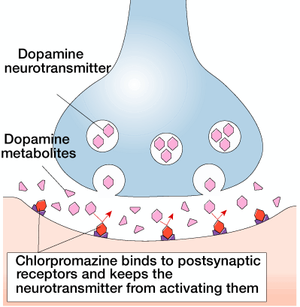
The biochemistry of schizophrenia
Dopamine hypothesis of schizophrenia
Excess or increased sensitivity to dopamine
Amphetamine & cocaine – increase dopamine activity and produce schizophrenic symptoms
Chlorpromazine acts as dopamine antagonist
Blocks postsynaptic receptor sites
Shown to bind to D2 dopamine receptor sites

Slide 20
NMDA and glutamate hypothesis
This theory suggests that the NMDA receptor is underactive or hypofunctioning
Gives rise to the negative symptoms and cognitive impairment seen in schizophrenia (Javitt & Zukin, 1991)
Psychosis-like effects of PCP and ketamine which are both NMDA receptor antagonists

Slide 21
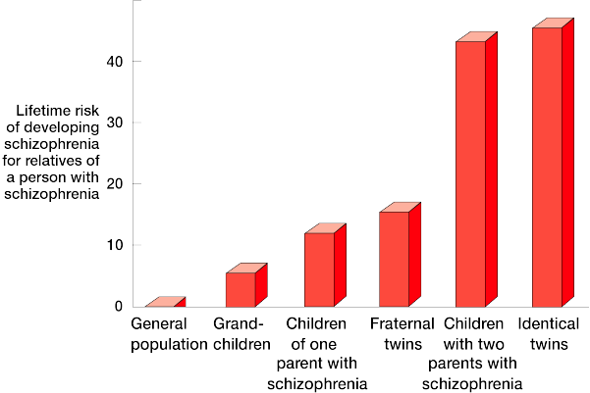
Risk factors of schizophrenia
Genetics
Concordance rate much higher for identical than fraternal twins
Gene neuregulin 1 are associated with schizophrenia in an Icelandic sample (Stefansson et al., 2002)
Most data suggests that we only inherit a predisposition

Slide 22
Risk factors of schizophrenia
Schizophrenics are more likely to have complications with pregnancy and childbirth, especially premature birth, low birth weight, and hypoxia (Clarke et al., 2006)
Smoking cannabis is also been identified as a possible factor
Two to four-fold increased risk of developing the disorder (Semple et al., 2005)

Slide 23
Brain damage and schizophrenia
Enlarged cerebral ventricles (Copolov & Crook, 2000)
Disrupted cellular organization in the cortex (Jones, 1995)
Brain imaging has revealed neural tissue loss around the frontal and anterior lobes and in the hypothalamus (Bogerts et al., 1992)
Lesions to the prefrontal – negative symptoms (Wolkin et al., 1992)

Slide 24
Neurological disorders
When a neurologic disorder is suspected, clinicians usually evaluate all of the body systems during the physical examination which focuses on the nervous system
Includes evaluation of mental status, cranial nerves, motor and sensory nerves, reflexes, coordination, balance and walking

Slide 25
The neurological examination
Divided into seven areas and performed in an planned, step-wise manner
General appearance, including posture, motor activity and vital signs
Mini mental status exam, including speech observation
Cranial nerves, I through XII.
Motor system, including muscle atrophy, tone and power
Sensory system, including vibration, position, pin prick, temperature, light touch and higher sensory functions
Reflexes, including deep tendon reflexes
Coordination and gait

Slide 26
Dementia: Alzheimer’s disease
5% of the population over the age of 65
20% over the age of 85
Alzheimer’s disease most common
Clinical assessment of Alzheimer’s disease over 80% accurate

Slide 27
Dementia
Other dementia
- Huntington’s disease
- Creutzfeldt-Jacob disease
- Lewy Body (varied up and down)
- Vascular (stable time then relapse)
Other causes and mimics of dementia
- Depression
- Delirium

Slide 28
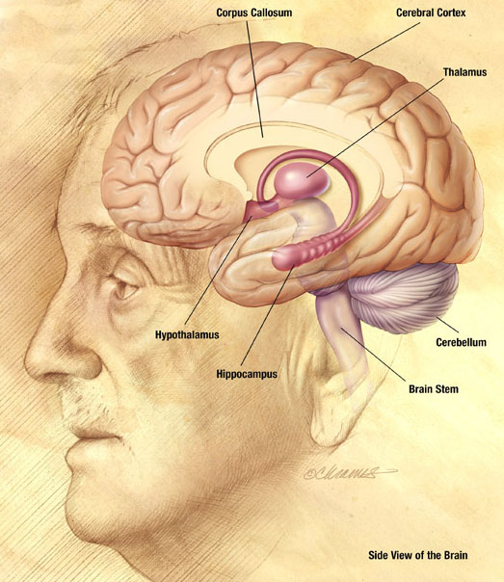
Symptoms of dementia
Vary in severity and order of appearance, based on type of dementia
All dimensions involve
- impairment of memory
- thinking
- reasoning
- language
- personality changes

Slide 29
The three As of dementia
Aphasia – language impairment
Apraxia – motor impairment
Agnosia – loss of ability to recognize objects

Slide 30
Stages of Alzheimer’s
Stage 1 – no impairment
Stage 2 – mild forgetfulness
Stage 3 – mild cognitive decline; earliest clear-cut deficits
Stage 4 – moderate cognitive decline; clear-cut deficit in careful clinical interview
Stage 5 – moderately severe cognitive decline; patient needs assistance with daily tasks
Stage 6 – severe cognitive decline; may occasionally forget the name of the spouse upon whom they are entirely dependent for survival
Stage 7 – very severe cognitive decline; severe loss of motor control, verbal speech lost

Slide 31
Classification of Alzheimer’s disease
Sporadic
occurs later in life and appears to be related to the apoE gene found on chromosome 19
Familial Alzheimer’s disease (FAD) or Early Onset Familial Alzheimer’s disease (EOFAD)
Autosomal dominant and appears to involve the prensenilin and APP genes

Slide 32
Neurotransmitters and the ACh hypothesis
Alzheimer’s disease has shown an association with deterioration in the following neurotransmitter systems:
acetylcholine (ACh)
noradrenaline
serotonin
Degereration of neurons of nucleus basalis of Meynert – acetylcholine

Slide 33
Beta amyloid hypothesis
Amyloid are plaque-like buildups of proteins
Cause holes in the brain
Cause destruction of neuron process

Slide 34
What causes amyloids?
Abnormal peptide fragment called beta amyloid (βA)
This βA protein is part of the amyloid precursor protein (APP), normally found in brains
Protease enzymes cleave βA fragments
These fragments form plaques

Slide 35
Amyloid preprotein (APP) gene
A 39-43 A.A. fragment which forms the core of the amyloid plaques
Located on chromosome 21
APP mutations may result in:
- overproduction of βA protein
- changed the configuration of APP
This facilitates abnormal cleavage, resulting in increased formation and deposition of βA
The association between Downs Syndrome and AD

Slide 36
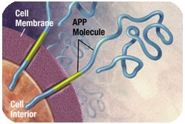
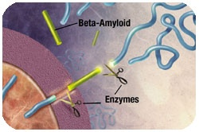
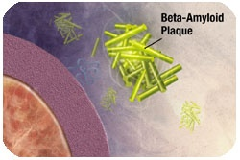
Beta amyloid hypothesis
Amyloid precursor protein (APP) is the precursor to amyloid plaque
1. APP sticks through the neuron membrane
2. Enzymes cut the APP into fragments of protein, including beta amyloid
Beta amyloid fragments
In AD, many of these clumps form, disrupting the work of neurons. This affects the hippocampus and other areas of the cerebral cortex

Slide 37
The tau hypothesis
Tau protein is essential for the growth of neurons and stabilization of microtubules
Tau is a microtubule associate protein (MAP) that is made up of a group of six proteins in mammals
Forms neurofibrillary tangles
Distribution and abnormal phosphorylation of tau are one key piece of the pathology of AD

Slide 38
Presenilin 1 gene
Early-onset AD
Located on chromosome 14
Function in healthy neurons:
- codes for a transmembrane protein involved with protein transport within cells or acts as a receptor or channel protein
It alters APP by forming longer Aβ protein

Slide 39
Presenilin 2 gene
Early-onset AD
Located on Chromosome 1
Function in normal healthy neurons:
- Protein transport within cells and/or a receptor or channel protein
There is a single mutation in PS 2 leading to AD
The Aβ protein is increased in plasma of people with the PS 2 mutation

Slide 40
Apolipoproteine E gene
Late-onset AD
Located on chromosome 19
There are 3 isoforms (alleles) for this gene:
- E2
- E3
- E4
The difference in each isoform is associated with a change in one of two positions on the peptide
There is an increased genetic risk factor associated with the E4 allele

Slide 41
ApoE gene
Its product may perform many functions in the brain
It is found in the extracellular space – bound or free
Its location suggest many functions, not all relevant to AD
ApoE may have a role in neuronal metabolism and neuronal degeneration and regeneration in the CNS
ApoE3 stabilizes microtubules by binding to tau, thus preventing abnormal phosphorylation and protecting cell integrity
ApoE4 does not do this

Slide 42
Other risk factors
Medical history
- History of head trauma
- Depression
Lifestyle factors
- Alcohol consumption
Environmental exposures
- Aluminum
- Lead

Slide 43
Parkinson’s disease (PD)
By the time of diagnosis at least 60% of dopamine neurons in the substantia nigra have already been lost
60-80 year olds
Both sexes equally affected
One in 1,000
60,000-80,000 affected in the UK
Less in Africa and China
No in-vivo biological markers
Clinical diagnosis 75% accurate

Slide 44
Symptoms of PD
Resting tremor
Cog-wheeling
Festinating gait
Rigidity
Bradykinesia
Dementia
Depression

Slide 45
Assessment scales
The original UPDRS is composed of 4 sections, including:
1. Mentation, behaviour and mood
2. Activities of daily living
3. Real-time assessment of motor features
4. Complications of therapy

Slide 46
Causes of PD
Genetic
PARK1 and PARK4 genes
leucine-rich repeat kinase 2 (LRRK2) gene (PARK8) is also an autosomal dominant gene
Parkin gene (PARK2) is autosomal recessive and the most common mutation related to young-onset PD (Lucking et al., 2000)
Environmental
Infections
Oxidative stress

Slide 47
Neural structures involved in PD
Nigrostriatal dopamine pathway
Transmits dopamine from the substantia nigra (SN) to the neostriatum – basal ganglia motor loop
Loss of pigment in substantia nigra and locus coeruleus (nucleus accumbens circuit)
SN – decrease in pigmented neurons (20% remaining) shrinkage of existing neurons
Lewy bodies
Neurofibrillary tangles in hippocampous, cerebral cortex, globus pallidus and hypothalamus

Slide 48
Pathology of PD
Loss of pigment in substantia nigra and locus coeruleus (nucleus accumbens circuit)
SN – decrease in pigmented neurons (20% remaining) shrinkage of existing neurons
Lewy bodies
Neurofibrillary tangles in hippocampous, cerebral cortex, globus pallidus and hypothalamus

Slide 49
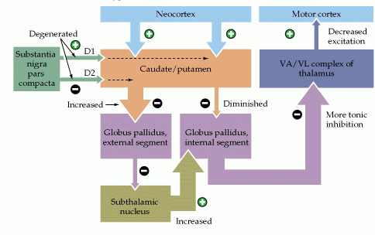
PD circuity
Axon loss in SN – inhibitory at D2
To globus pallidus
Increases in excitation
= increased inhibition to thalamus
= decreased excitation to cortex

Slide 50
Management of PD
Balance dopamine and acetylcholine
Anticholinergics
treat tremor and salivation
L-dopa
Transplantation
Ventromedial pallidotomy
Thalamic stimulation

Slide 51
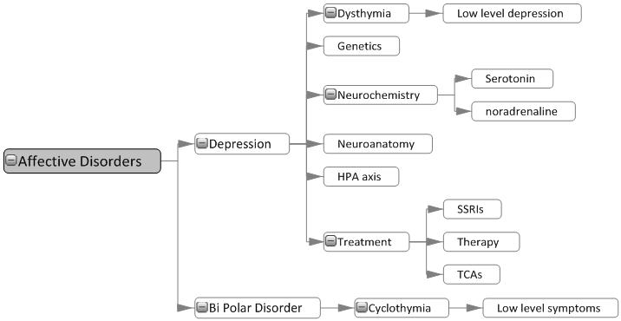
Affective disorders

Slide 52
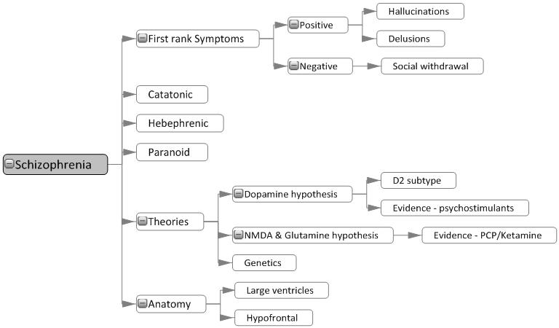
Schizophrenia

Slide 53
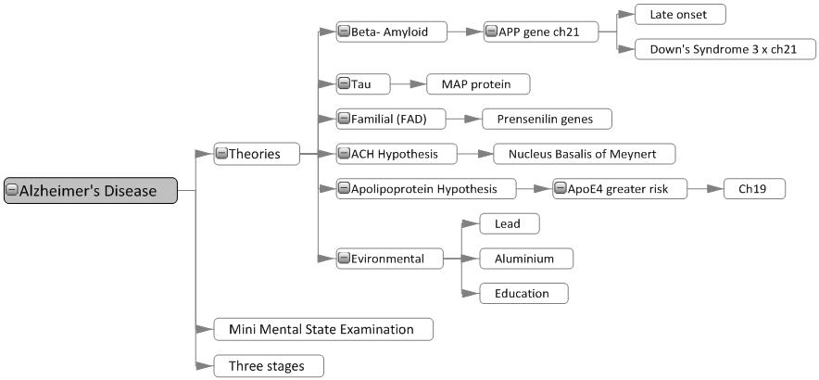
Alzheimer’s disease

Slide 54
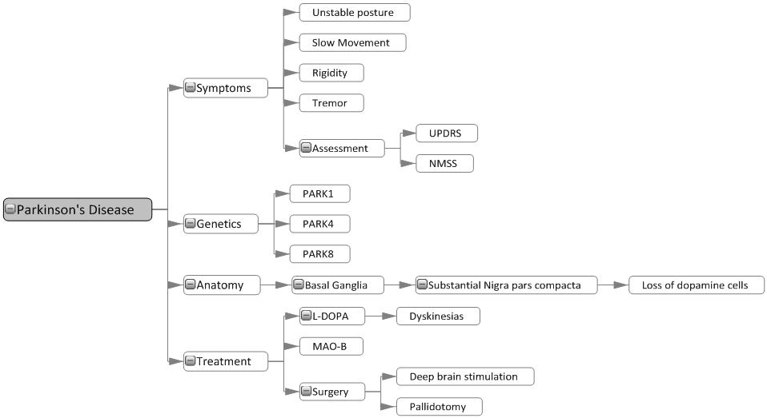
Parkinson’s disease

Slide 55
Readings
Barnes, J. (2011). Essential Biological Psychology (Chapter 13). London: Sage.
The Essentials
Isacson, O., Seo, H., Lin, L., Albeck, D., & Granholm, A.C. (2002). Alzheimer's disease and Down's syndrome: roles of APP, trophic factors and ACh. Trends in Neuroscience, 25(2), 79-84.
Next Steps
Schultz, S.H., North, S.W., & Shields, C.G. (2007). Schizophrenia: a review. American Family Physician, 75(12), 1821-1829.
Delving Deeper
Lux, V., Aggen, S.H., & Kendler, K.S. (2010). The DSM-IV definition of severity of major depression: inter-relationship and validity. Psychological Medicine, 40(10), 1691-1701.

